Slide 1


CE251: Java PROGRAMMING
July – November 2020
Chapter – 2
Java Constructor

Slide 2
Example
class Test
{
// logic here
}
Create object of a Test class Test t = new Test();
NOTE: During the object creation constructor will be executed

Slide 3
Instantiation vs. Initialization in context of object
Instantiation //
Test t ;
Initialization //
t = new Test();

Slide 4
How many different approach to create an object in java?

Slide 5
What are the rules to declare constructor in java?

Slide 6
Few Question must have in your mind about constructor rules.
Why constructor name is same as class name?
Why return type is not allowed for constructor?
Can we declare constructor as public, private, protected?

Slide 7
Example
class Test
{
void m1()
{
S.O.P.(“M1 method”);
}
P.S.V.M(String[] args){
Test t = new Test();
}
}
/*
Test()
{
// empty implementation
}
*/
Zero argument constructor
Type of default constructor

Slide 8
Types of constructor
Default Constructor
Always Zero argument constructor
2. User define Constructor
Zero argument constructor
Parameterized constructor
NOTE:
Default Constructor generated by compiler and executed by JVM

Slide 9
User define constructor example (Constructor Overloading )
class Test
{ void m1() { S.O.P.(“M1 method”); }
Test()
{ S.O.P.(“0-argument constructor”); }
Test(int a)
{ S.O.P.(“1-argument constructor”); }
P.S.V.M(String[] args){
Test t = new Test();
Test t1 = new Test(10);
t.m1(); t1.m1();
}
}

Slide 10
Will it compile or not?
class Test
{
Test(int a)
{ S.O.P.(“1-argument constructor”); }
P.S.V.M(String[] args){
Test t = new Test();
Test t1 = new Test(10);
}
}
Default constructor will not be
Generated in this case
Compiler error

Slide 11
What is the purpose of constructor in program?
Two purpose or two advantages of constructor
Constructor are user to write business logic of application those logic are executed during object creation.
To understand second advantage, we must know use of this keyword

Slide 12
Case-01
class Emp{
int eid;
String ename;
float esal;
void display(){ S.O.P.(“Emp id is : ”, +eid);
S.O.P.(“Emp name is : ”, +ename);
S.O.P.(“Emp salary is : ”, +esal); }
P.S.V.M(String[] args){
Emp e = new Emp();
e.display();
} }
Output:
0
Null
0.0

Slide 13
Case-02
class Emp{
int eid;
String ename;
float esal;
Emp() { eid=123; ename = “XYZ”, esal= 1000;}
void display(){ S.O.P.(“Emp id is : ”, +eid);
S.O.P.(“Emp name is : ”, +ename);
S.O.P.(“Emp salary is : ”, +esal); }
P.S.V.M(String[] args){
Emp e = new Emp();
e.display();
} }
Output:
123
XYZ
1000
Constructor uses to initialize some values to instance variable during object creation

Slide 14
What is the problem in case-02?
With the given logic, for all the object of Emp class, same value will be initialize
Means different object but same value will initialize
What is the solution?

Slide 15
Parameterize constructor
Emp(int eid, String ename, float esal)
{
this.eid = eid;
this.ename = ename;
this.esal = esal;
}
Emp e1 = new Emp(111, “abc”, 1000);
Emp e2 = new Emp(222, “xyz”, 2000);

Slide 16
Can we create object inside constructor?

Slide 17
Will it work or not?
class Test { Test() { new Test(); } public static void main(String[] args) { System.out.println("Main Method"); new Test(); } }
It is possible to create object inside constructor.
It will not give compile time error, but it is not recommended to create.
If we create object inside constructor, it invokes the constructor recursively.
Hence it cannot complete the process of Object creation.

Slide 18
Can we define a method with same name of class?

Slide 19
Will it compile or not?
class Test
{
void Test()
{
System.out.println("This is a method not a constructor");
}
public static void main(String[] args)
{
System.out.println("Hello World!");
Test t = new Test();
t.Test();
}
}
YES

Slide 20
If we place return type in constructor prototype will it leads to Error?
NO
Reason- No, because compiler and JVM considers it as a method.

Slide 21
How compiler and JVM can differentiate constructor and method definitions of both have same class name?
Ans- A compiler and a JVM differentiates constructor and method invocations by using 'new' keyword. If 'new' keyword is used in calling then a constructor is executed else method is executed.

Slide 22
Will it compile or not?
class Test
{
Test()
{
System.out.println("0-arg Constructor");
}
void Test()
{
System.out.println("THis is method not constructor");
}
public static void main(String[] args)
{
System.out.println("Hello World!");
Test t = new Test();
t.Test();
}
}
Compile and run successfully
By return type

Slide 23
How compiler and JVM can differentiate constructor and method invocations of both have same class name?
by new Keyword

Slide 24
What is the difference between constructor and method in java?
write it in your own

Slide 25
Java Constructor Access Modifiers
Constructors can have any of the access modifiers: public, protected, private, or none.
Constructors cannot be abstract , final , native , static , or synchronized .

Slide 26
Copy Constructor
There are many ways to copy the values of one object into another in java. They are:
By constructor
By assigning the values of one object into another
By clone() method of Object class

Slide 27
WHY ?
Copy constructors are widely used for creating a duplicates of objects known as cloned objects.
Duplicate object in the sense the object will have the same characteristics of the original object from which duplicate object is created.
But we have to ensure that both original and duplicate objects refer to different memory locations.

Slide 28
Example
class CopyConstructor{
int id;
String name;
CopyConstructor(int i,String n){
id = i;
name = n;
}
CopyConstructor(CopyConstructor s){
id = s.id;
name =s.name;
}
void display()
{
System.out.println(id+" "+name);
}
public static void main(String args[]){
CopyConstructor s1 = new CopyConstructor(111,"Karan");
CopyConstructor s2 = new CopyConstructor(s1);
s1.display();
s2.display();
}
}

Slide 29
Concept of destructor in JAVA
What is the aim of destructor in any OOPs language?
1. Free up the memory (c++ suffer from memory allocation / deallocation)
2. Clean up any other resources (like closing of open file stream)

Slide 30
Java take cares of all and hence there is no destructor in Java.
With the help of Garbage collection

Slide 31
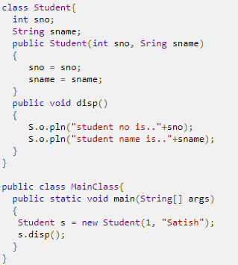
What is the output?
A. Student no is.. 1 student name is.. Satish
B. Compile time error in constructor
C. Run time error in constructor
D. Student no is.. 0 student name is.. null

Slide 32
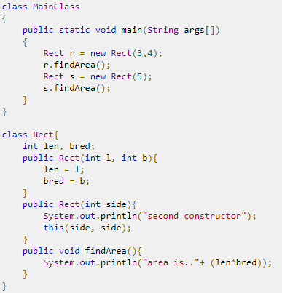
What is the output?
A. compile time error
B. Run time error
C. It prints area is.. 12 and area is.. 25
D. It prints area is.. 25 and area is.. 25

Slide 33
What is constructor overriding?
Constructors can not be overridden in Java
Since constructor are special function which can’t be inherited to derived classes, so it is not possible for derived classes to override a constructor of base class
Derived classes can call base class constructor by using super keyword
All are correct

Slide 34
Reference
https://deepeshdarshan.wordpress.com/2013/12/05/copy-constructors-in-java/

